Slide 1
Business Central Telemetry
Tools and Performance Management

Slide 2




Your Speaker
Marcel Chabot
Software Development Practice Manager
A life-long software developer and “maker”, Marcel brings experience and a unique approach to complex problems and solutions in D365

Slide 3
Session Goals
Identify tools and technology to analyze Business Central Performance
Understand the limitations of each tool set
Breakdown the common barriers to good Business Central Performance
Have a good time and learn something

Slide 4
Session Agenda
Tools and Technology
  In Business Central Performance Profiler
  Application Insights
  Visual Studio Code
Reporting and Analysis
  KQL Reporting
  Power BI Dashboards
Case Study Analysis
Q&A
Notes:
Performance montor
Application Insights
Power BI Report
Database indexes
Locked Tables
A lot to cover… Can’t do live demo, BC behaves during this demo.
Had to do a lot of slides….

Slide 5


Notes:
We are all in this together!
We can do this… we are locked in… keep your eyes on me, don’t look at the slide count! We can do this together!

Slide 6
Tool 1 Performance Profiler
Notes:
Profiling vs monitoring – Targeted search for an issue vs. recording performance over time to build a trend.

Slide 7
Business Central Performance Profiler
Built-in to Business Central
  Also called the In-Client Performance Profiler
Useful to isolate a repeatable problem
Can be used to benchmark a process
Limited to 10 minutes or 100mb whichever comes first.
Notes:
Profiling vs monitoring – Targeted search for an issue vs. recording performance over time to build a trend.

Slide 8
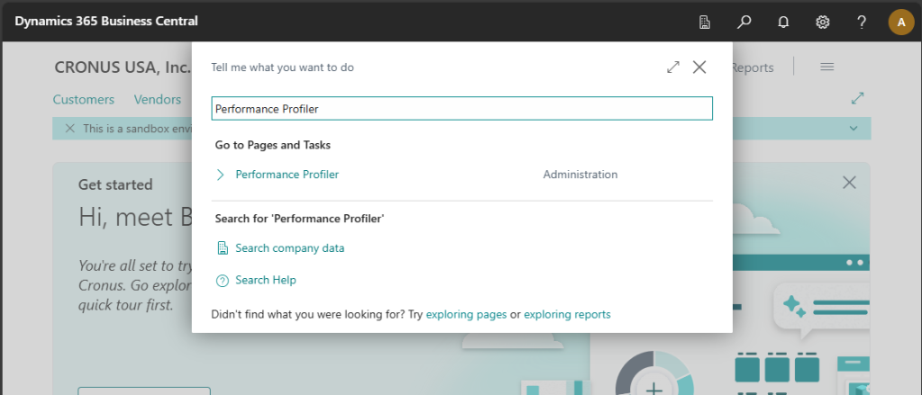

Slide 9
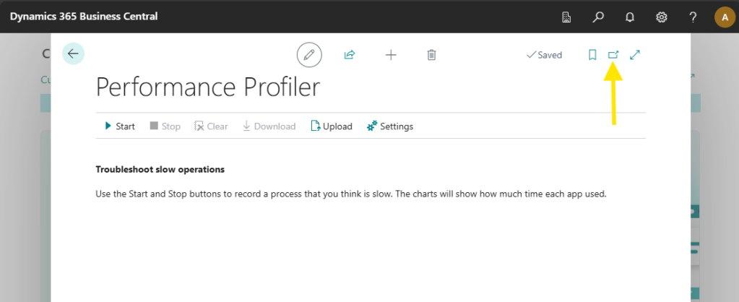

Slide 10
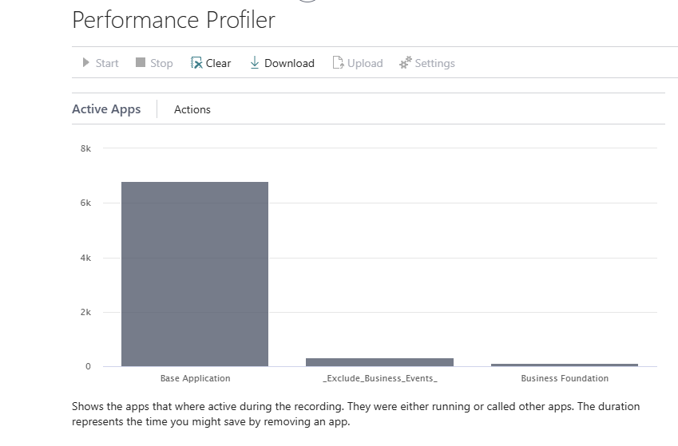

Slide 11
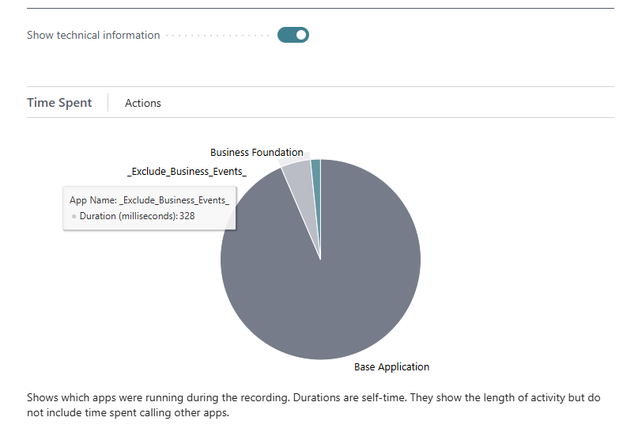

Slide 12
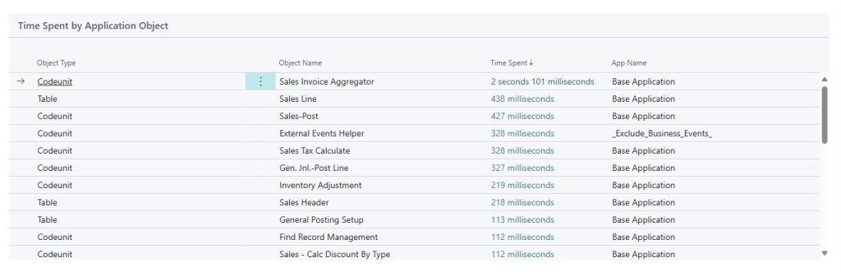

Slide 13
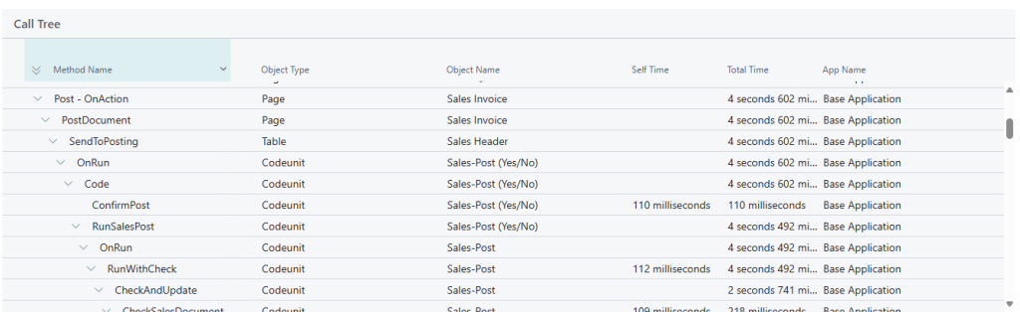

Slide 14
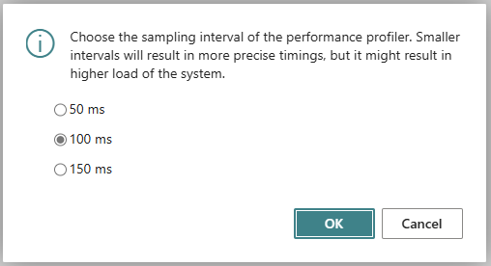

Slide 15
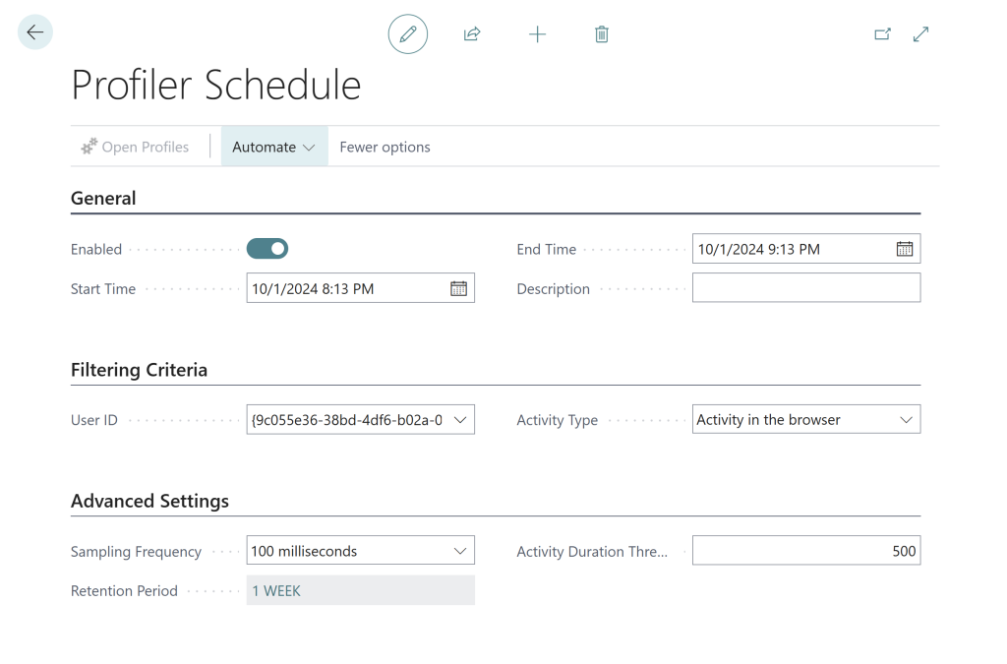
Sneaky Issues
Schedule to capture performance issues
  Time
  User
  Duration

Slide 16
Tool 2 VS Code Snapshot

Slide 17
Visual Studio Code
Attaches to a running Business Central
Can replay the issue over and over again
Deep and detailed analysis
10 Minute or 100mb limit
Can have a large performance impact!

Slide 18
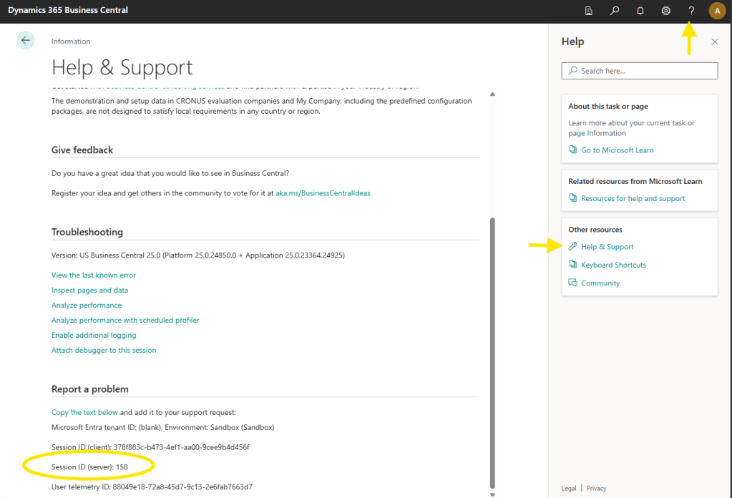

Slide 19
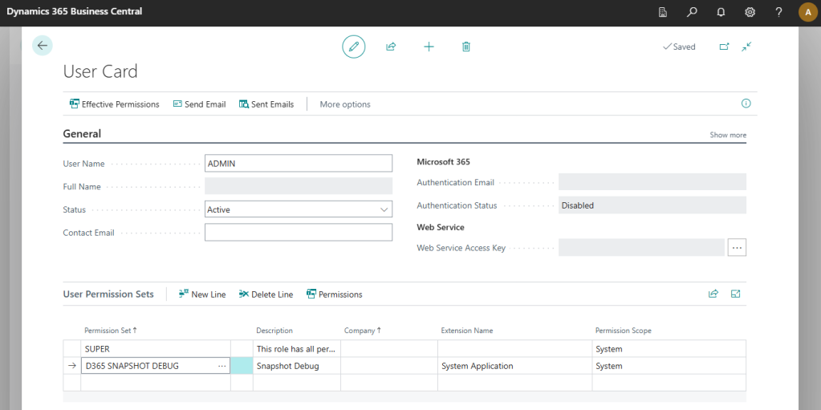

Slide 20
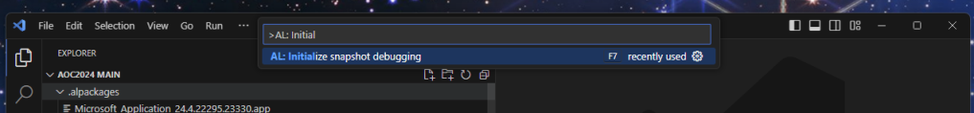
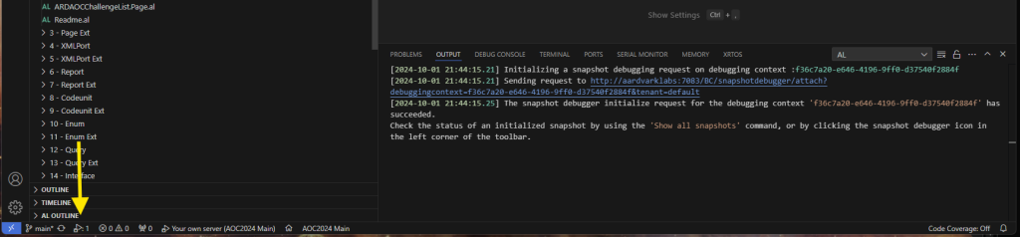

Slide 21
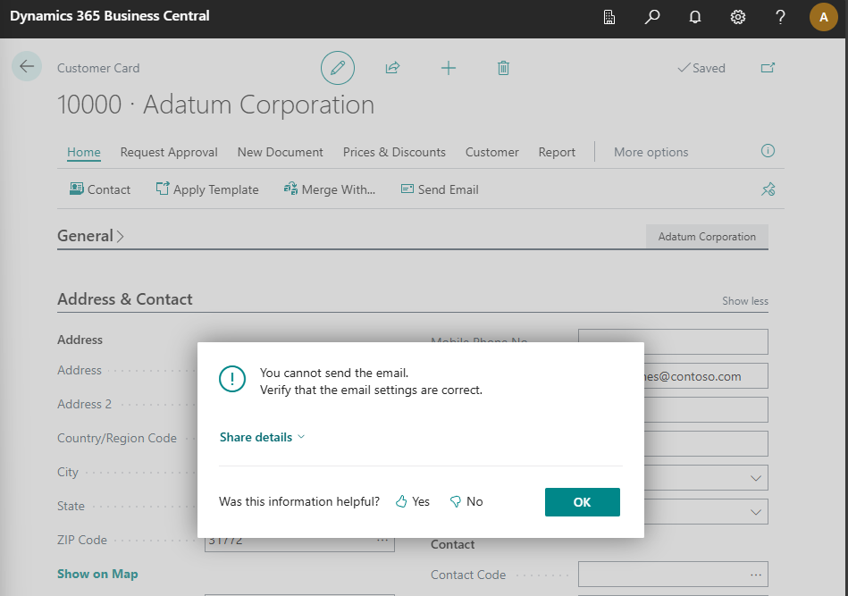

Slide 22
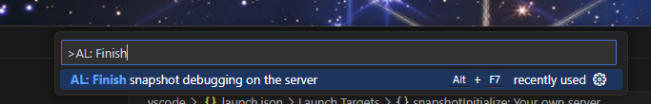
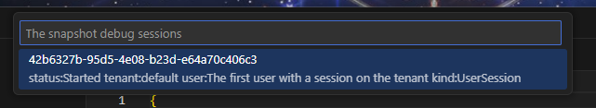
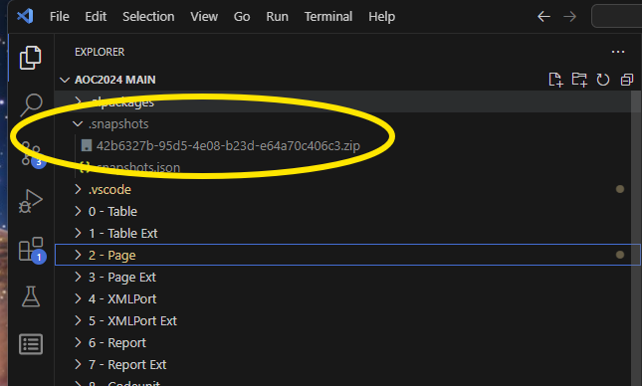

Slide 23
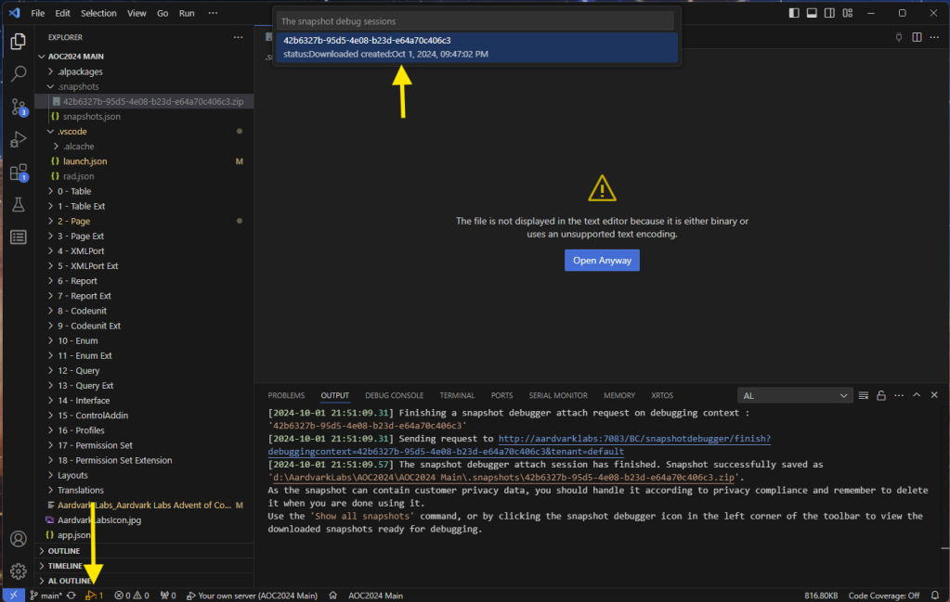

Slide 24
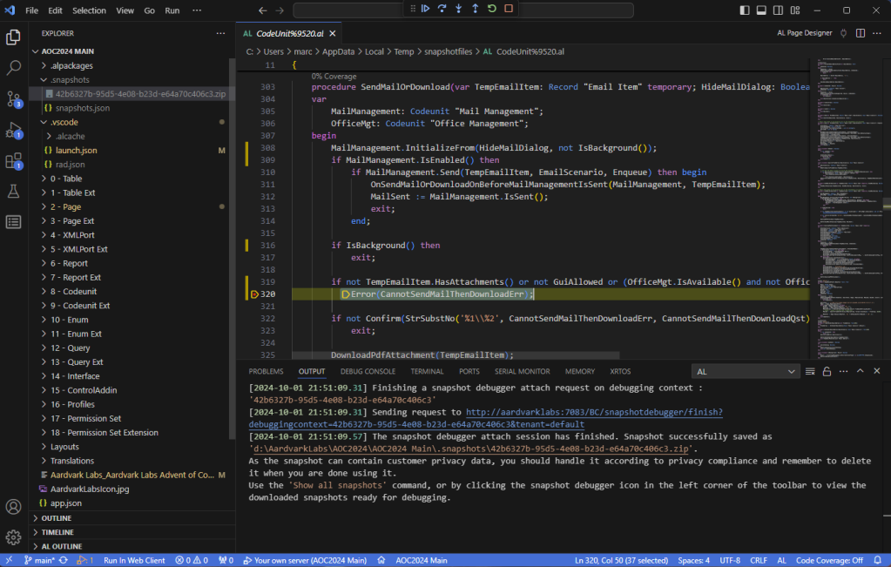

Slide 25
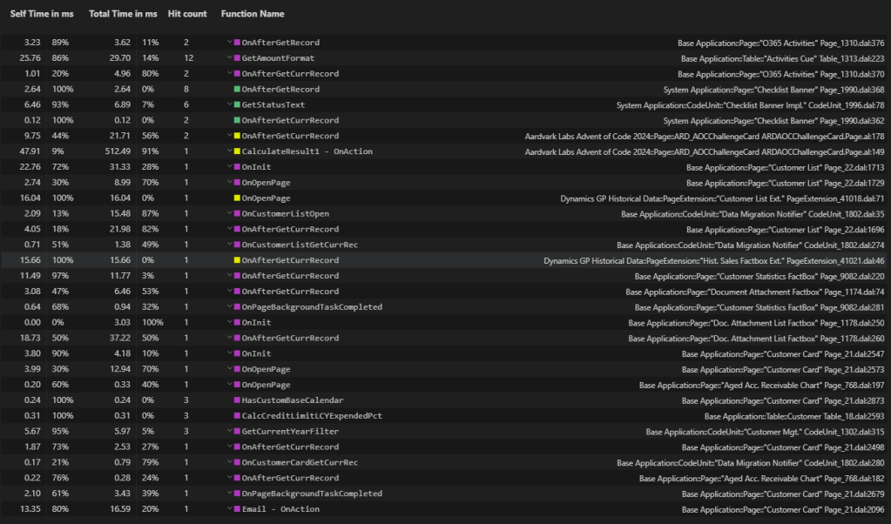

Slide 26
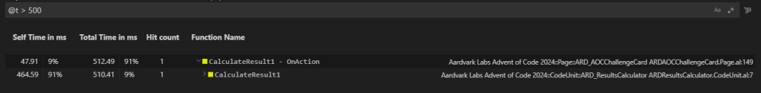
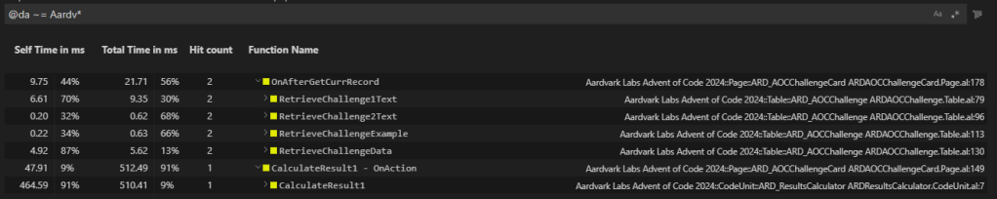

Slide 27
Tool 3 Application Insights

Slide 28
Application Insights
Azure Service
Long term performance tracking
Defaults to monitoring 30 days of data
Can cost money, typically less than a Starbucks run.
Notes:
The amount of telemetry data keeps going up, but then again, so does Starbucks coffee costs.
Profiling vs monitoring.

Slide 29
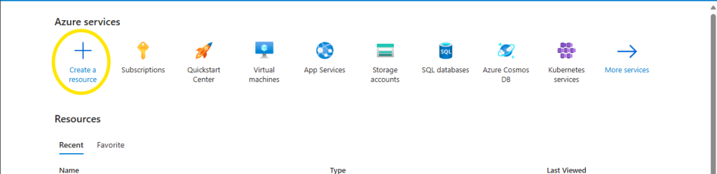
Step 1: Application Insights

Slide 30
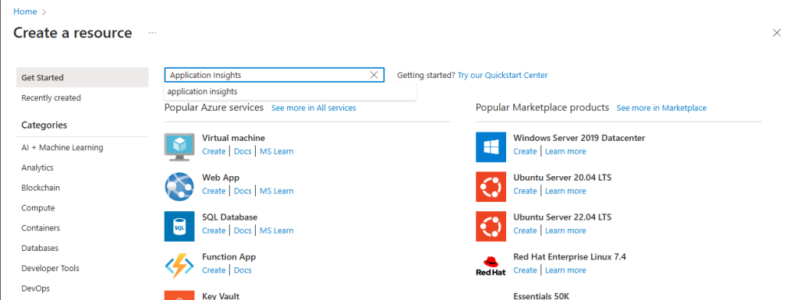

Slide 31
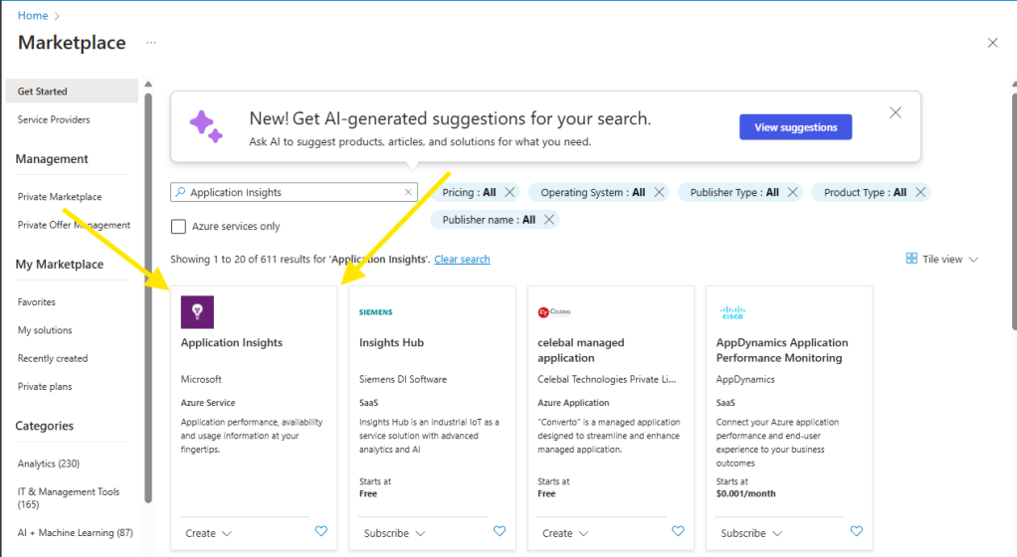

Slide 32
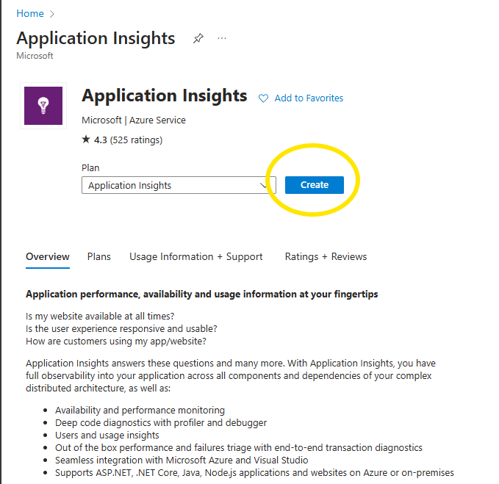

Slide 33
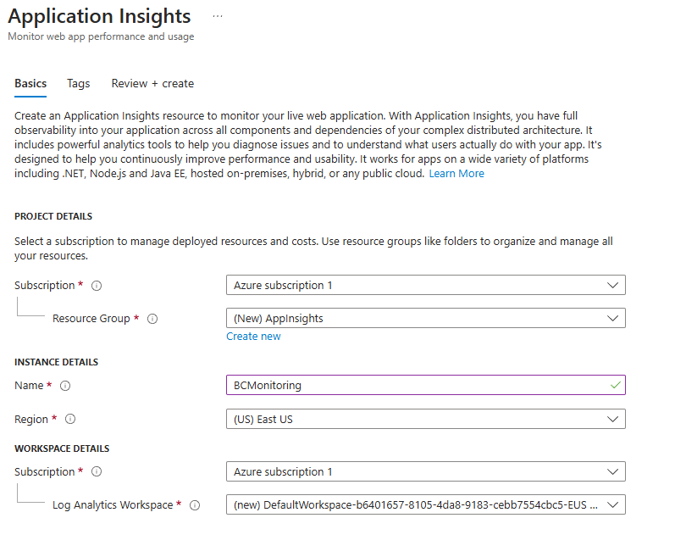

Slide 34
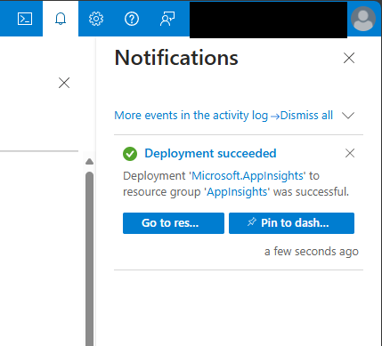
Finalize Application Insights
Review + Create

Slide 35
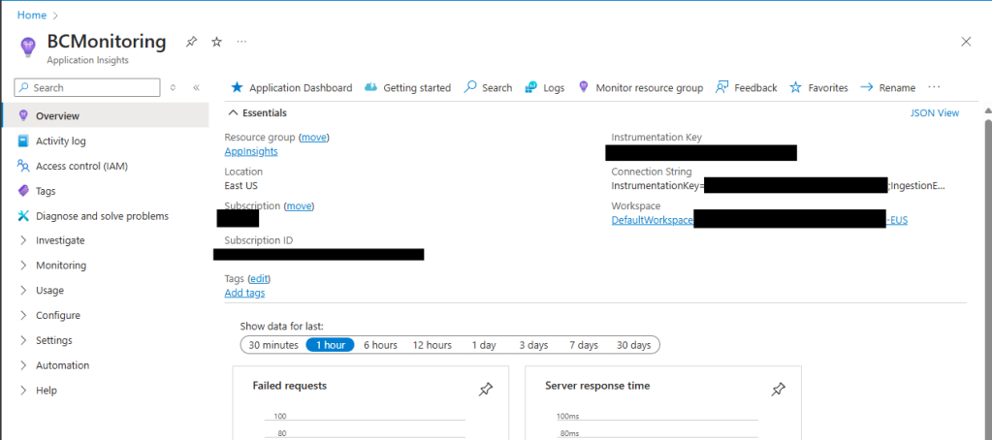
Notes:
Note the redacted connection string!

Slide 36
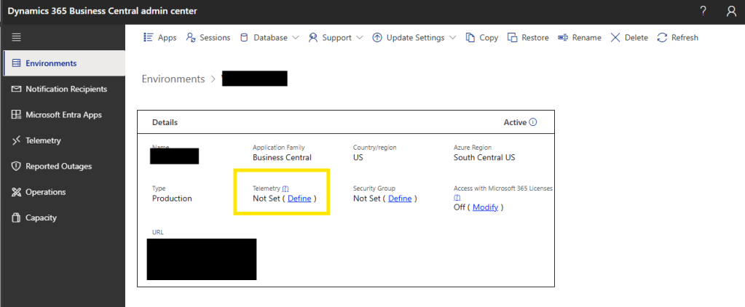
Notes:
Peoples work will be interrupted and handhelds will require a reconnect

Slide 37
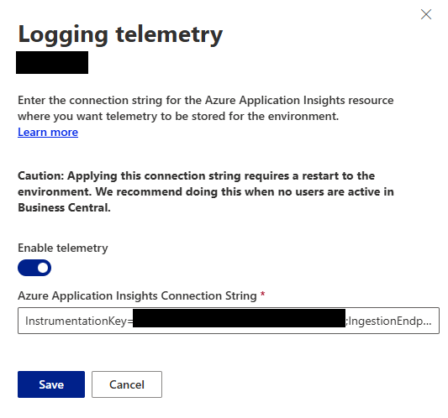
Configure BC
Paste in Connection String
BC will reboot!!!

Slide 38
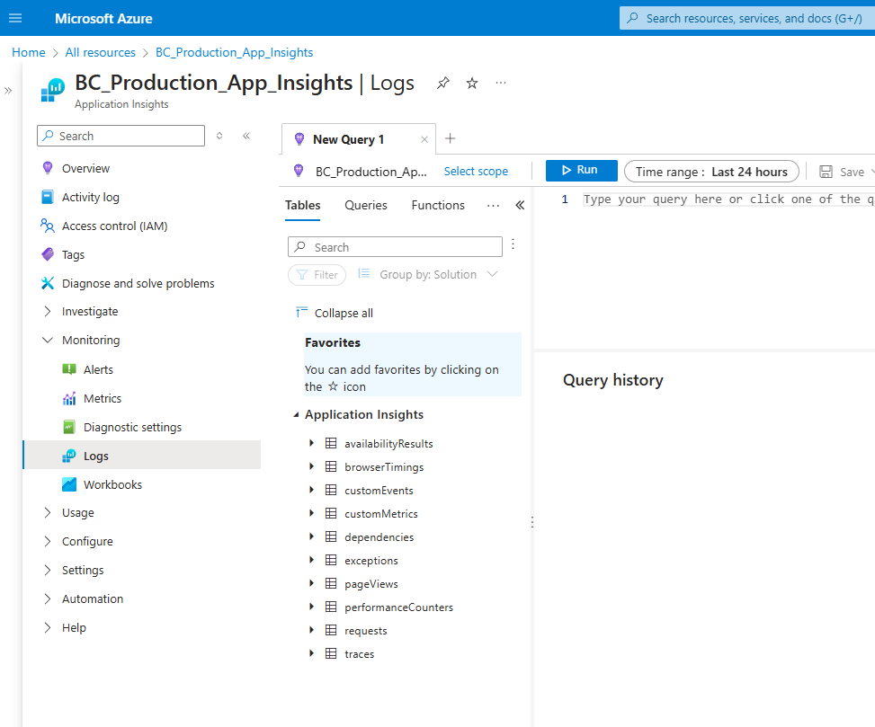

Slide 39
Tracked Metrics
Browser Timings
Page Views
Traces

Slide 40
The Kusto Query aka KQL
The query language used to parse Telemetry files
Useful to filter through the scads of data
Very useful when exporting the query to Power BI
Notes:
I’m glad I worked the word “scads” in here, it means a lot to me.

Slide 41
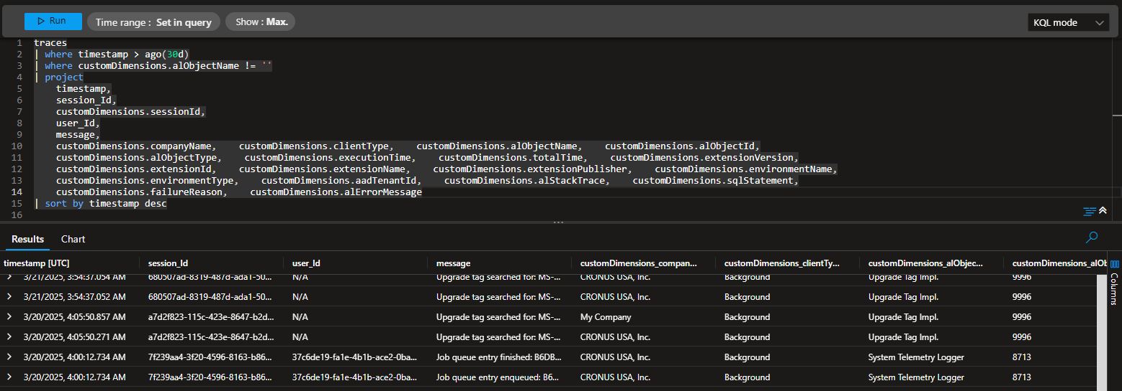

Slide 42
Analyze and monitor telemetry with KQL
https://learn.microsoft.com/en-us/dynamics365/business-central/dev-itpro/administration/telemetry-analyze-with-kql#how-can-i-query-telemetry-from-log-analytics

Slide 43
Tool 4 Power BI Dashboard

Slide 44
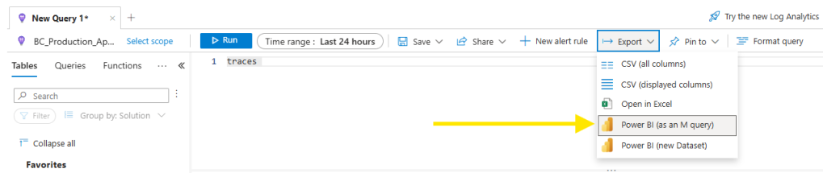
Power BI Reporting

Slide 45
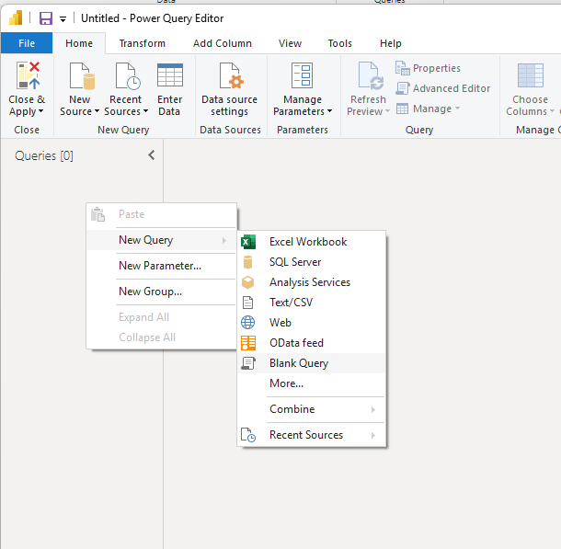
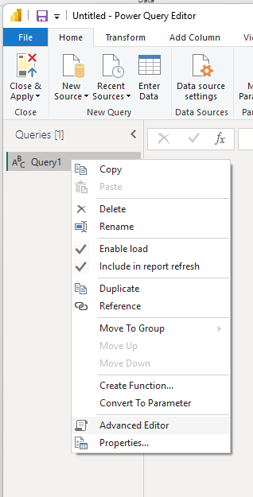

Slide 46
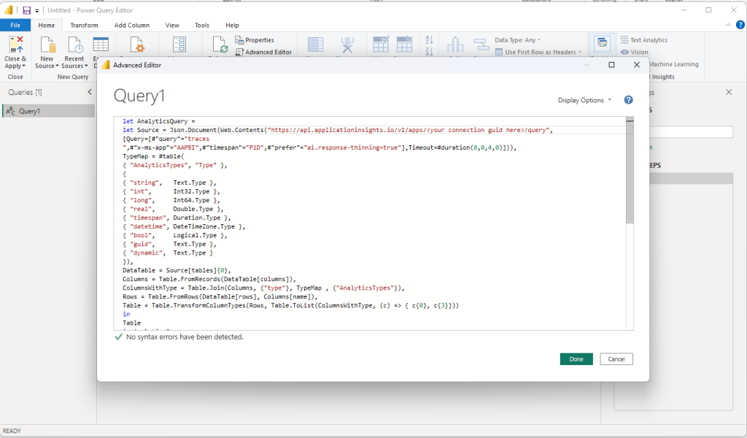

Slide 47
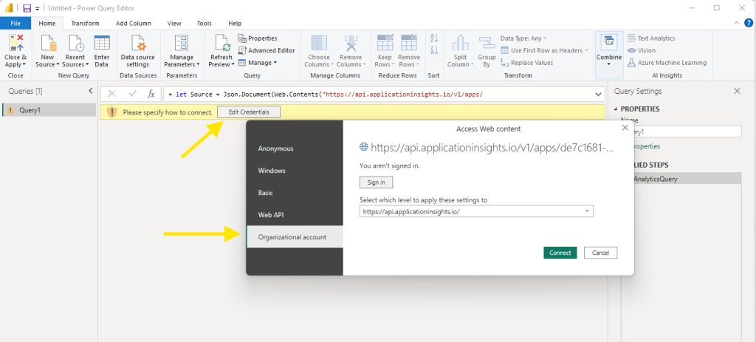

Slide 48
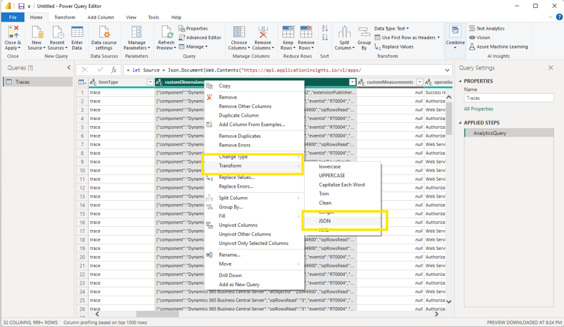

Slide 49
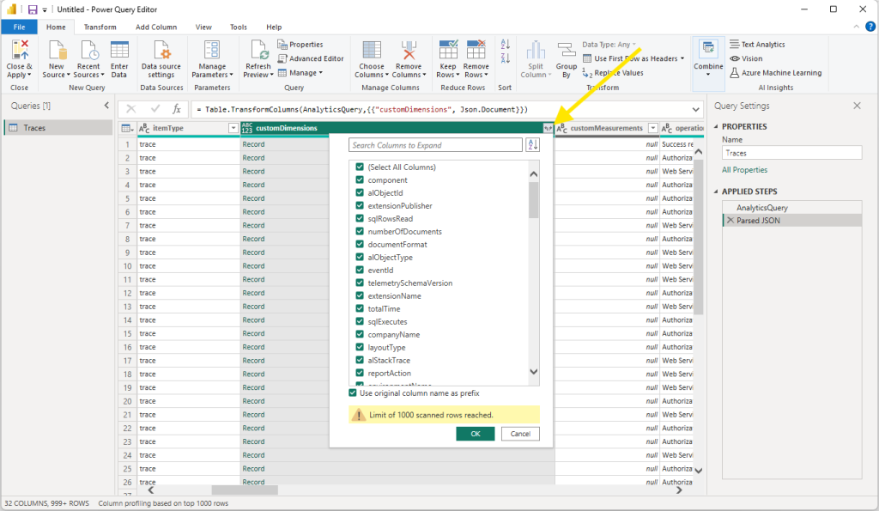

Slide 50
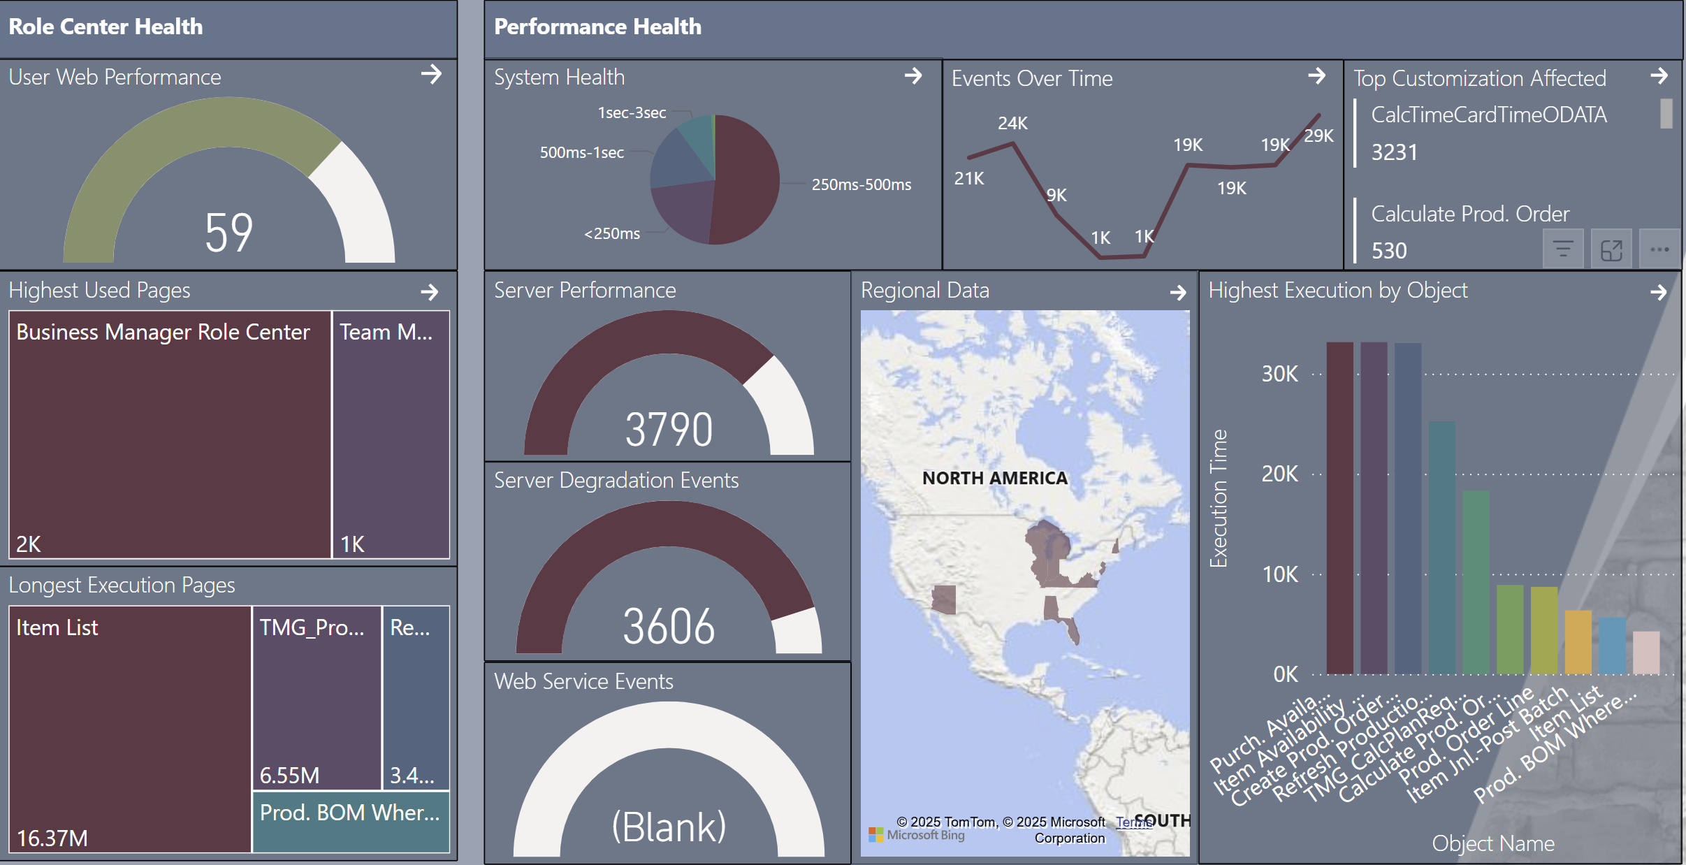

Slide 51
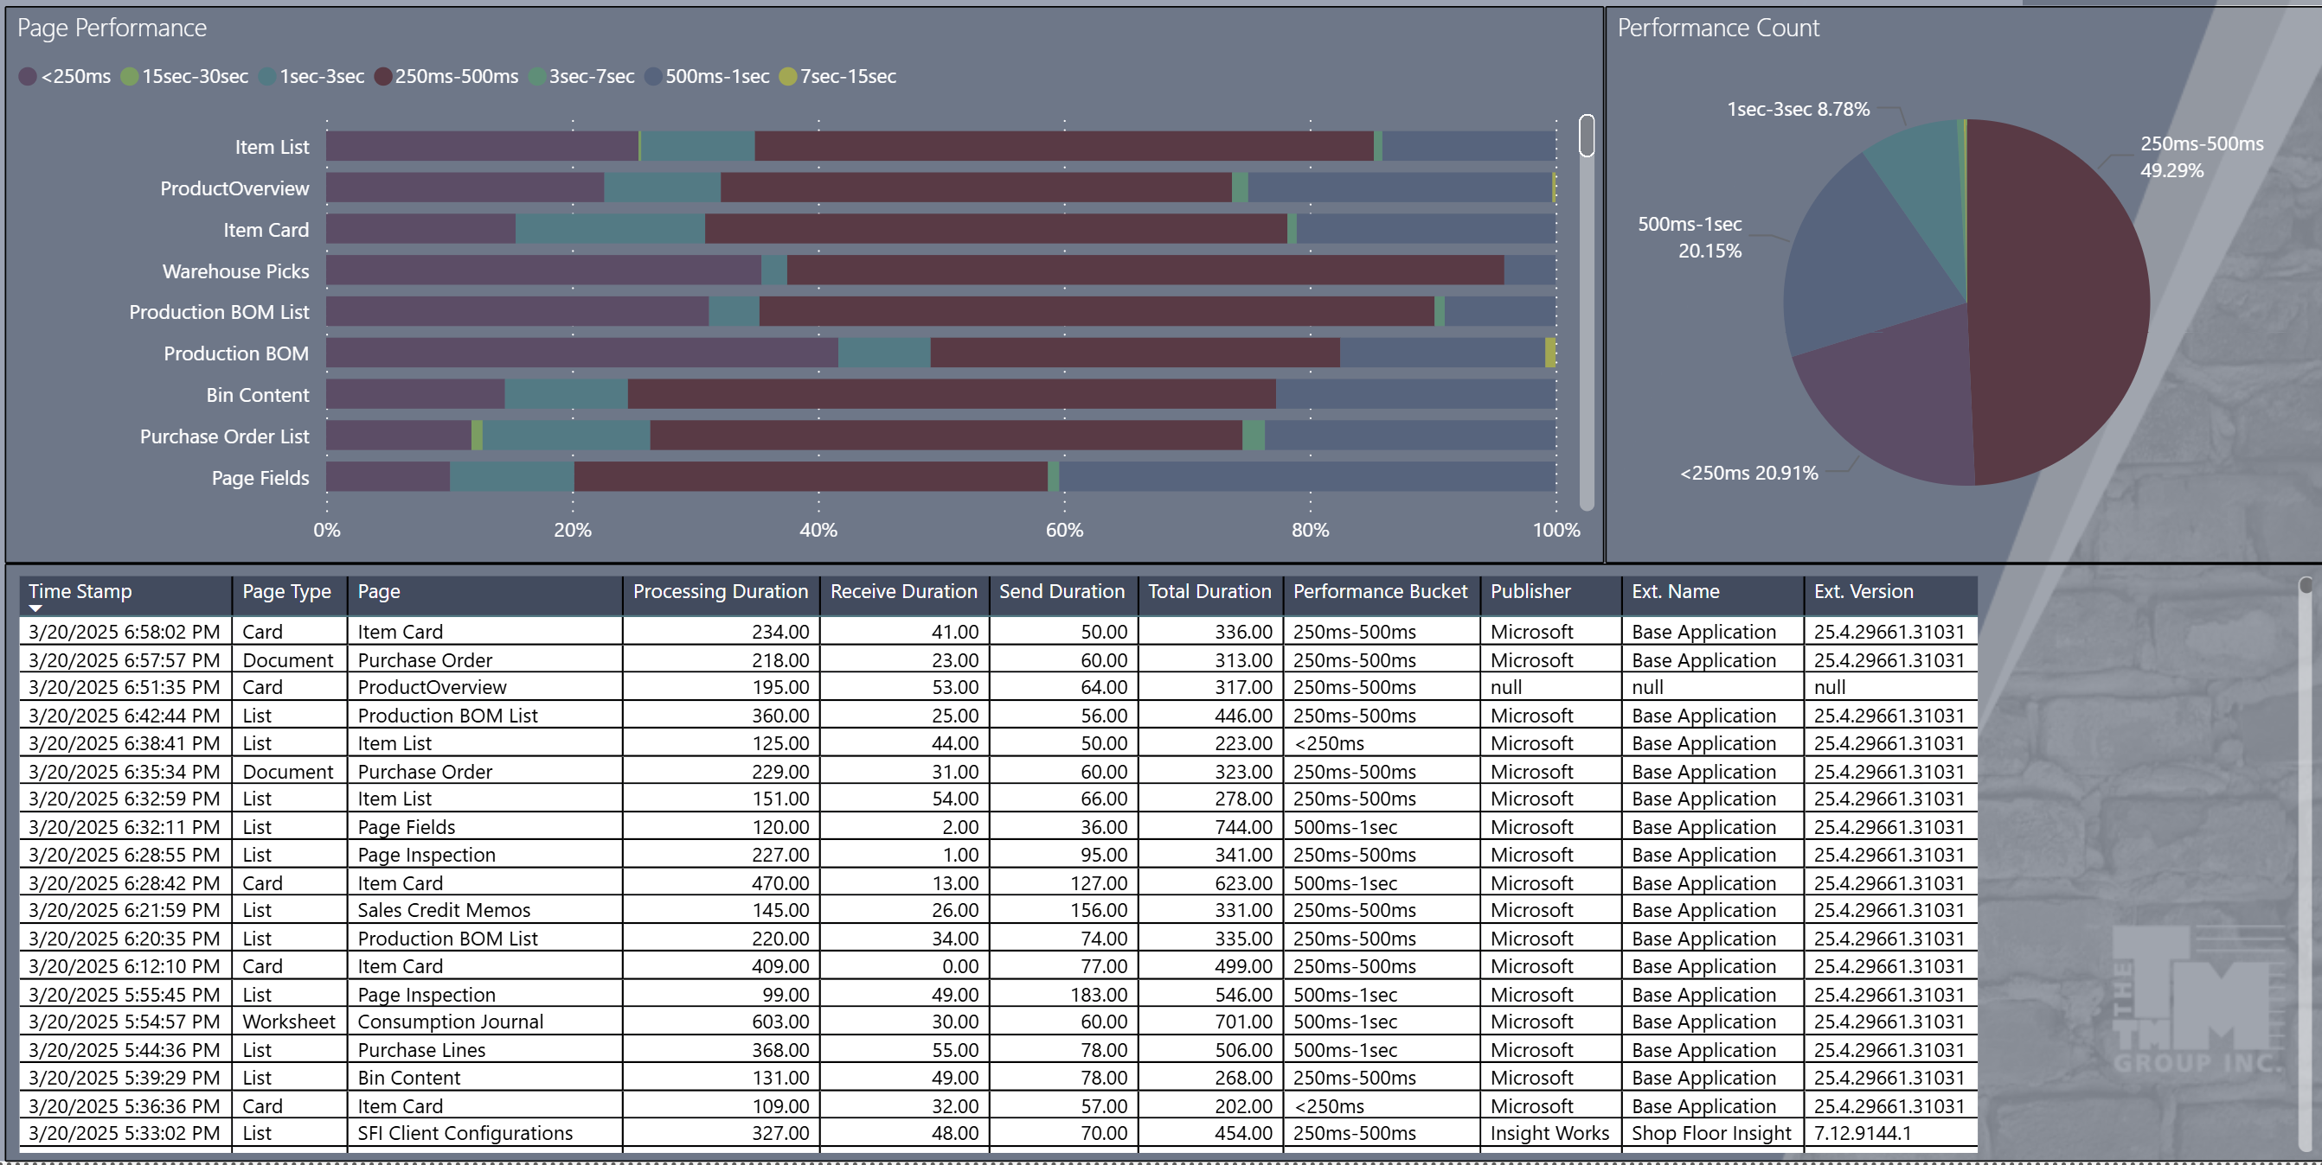

Slide 52
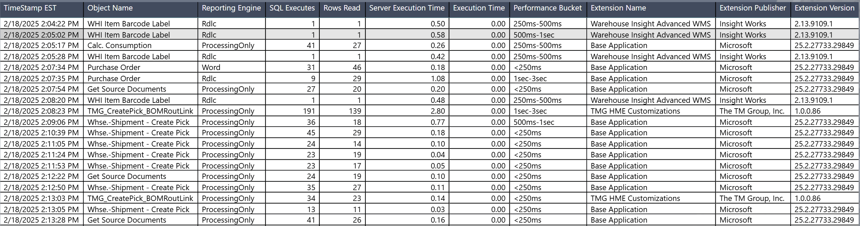
Report Load Performance

Slide 53
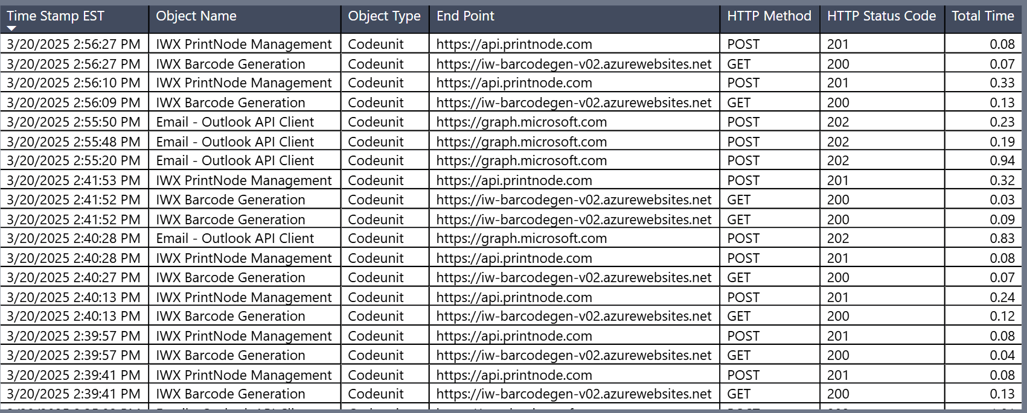
Web Service Performance

Slide 54
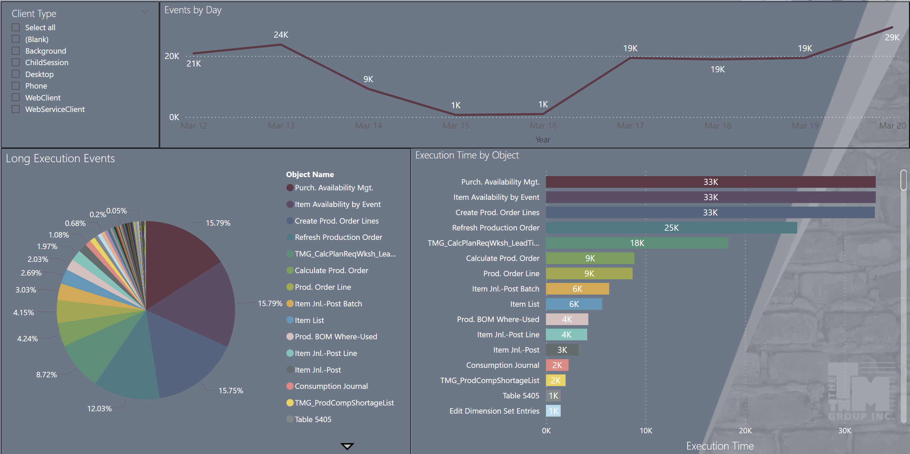
BC Object Performance

Slide 55
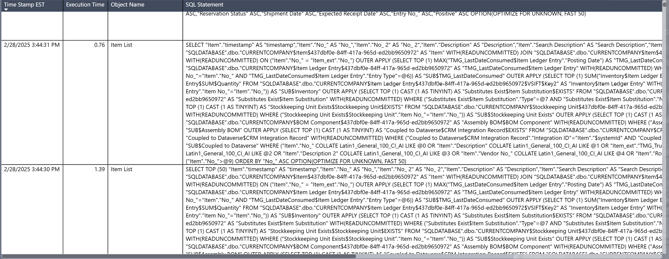
SQL Performance
Notes:
Business Central Performance Toolkit Extension, Power BI Reports based on Application Insights.

Slide 56
Common Issues
and how to address them.

Slide 57
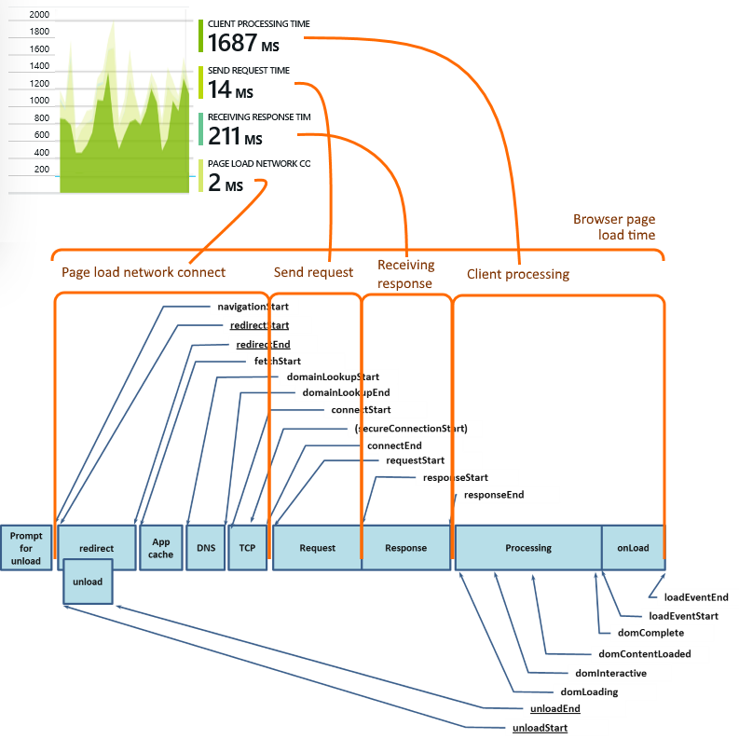
Network Analysis
Network Duration
Send Duration
Receive Duration
Processing Duration
Notes:
Network Duration: The time it takes for the browser to connect to the web page. If this number is high, the computer may be having an issue on the local network, or there is an issue between the network and the Azure hosting of Business Central. This is the low-level computers connecting to computers phase.
Send Duration: This is the time, after the computer has connected to the server, for the request to be sent. Retrieving records this should be very fast; on saving of a record this could be slower.
Receive Duration: The amount of time it takes to receive the data from the server. This can become slow if there is a lot of data, graphics, and other elements on the page.
Processing Duration: This is the bulk of the time spend on a page. This is the time to render the page, display all the elements, perform any page scripts, the basic DOM load tasks. If this starts taking too long, you may consider reducing the number of elements on the page. Creating task specific pages can greatly reduce the Processing duration.
Processing duration can also be impacted by other browser tasks that are running. Having a lot of tabs open, having streaming music running in one of those tabs, and the scrolling news page in another tab, all these tabs are consuming browser resources and consuming the available page processing resources. When I'm debugging a slow page issue, I always ask for a screen shot including all open tabs.

Slide 58
Slow Data Retrieval
Too many rollups
Too many OnAfterGetRecord calculations
Insufficient Database Indexing
Notes:
Slow Object, Slow SQL
Rollups don’t calculate when not on the screen

Slide 59
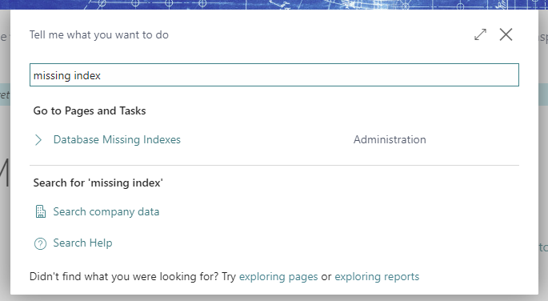
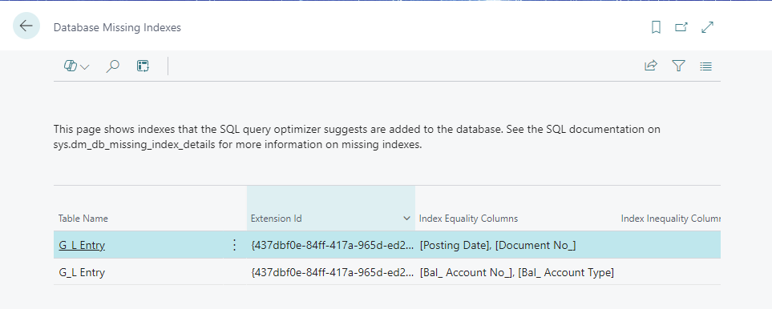
Database Missing Index

Slide 60
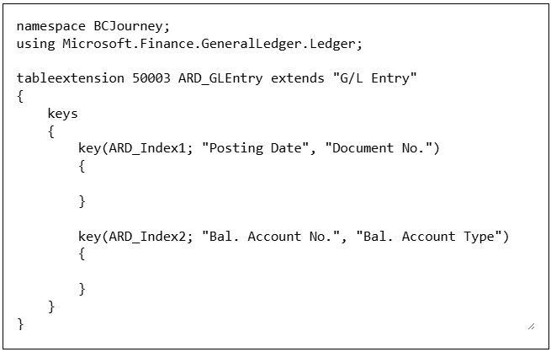
Adding Indexes to Business Central
Added to the Tables in BC
Needs to be an Extension
Indexes improve Load Time
Indexes cost Save Time

Slide 61
Flow Field Tax
Flow Fields perform aggregation over a data set
  Min, Max, Sum, Lookup…
Performs a large data query and should be properly indexed
SIFT Keys are important for Min/Max/Sum calculations
Can have a high impact when used on a List
Best on a limited list, card, or fact box
Notes:
Sum Index Field Technology = Makes SUM Flow Fields FASTER

Slide 62
Inefficient OnGetRecord
Can be used to perform calculation not possible with a Flow Field
Could be even more costly than a Flow Field
Runs on Lists in the background, adding data costs
Use on Cards, sparingly on Lists

Slide 63
Database Locked Tables
Many processes in BC require exclusive access to a table.
These should be designed to complete quickly, but…
Poor indexing could drive these processes to take too long
  Under indexing OR over indexing
Moving to scheduled jobs or delegated responsibility

Slide 64
Reporting APIs
A special designation in the design of an API
Uses a Read Only version of the tables to avoid locks
Not an option when exposing a Page as a Web Service
Notes:
Microsoft gives you TWO databases! The second is a realtime clone of the primary database specifically for reporting.
These Read Only APIs should be the primary source for all Power BI, or Connect Excel reporting data.

Slide 65
Auto Tuning
Use the system!
Microsoft adjusts server resource allocations based on usage
Don’t back off due to slowness during go-live

Slide 66
Questions?

Slide 67
Walkthrough Blog Posts
Performance Profiler
  https://aardvarklabs.blog/2024/10/11/monitor-business-central-performance-with-performance-profiling/
VS Code Snapshot
  https://aardvarklabs.blog/2024/10/25/development-of-responsive-al-code-with-the-al-performance-tools/
Application Insights
  https://aardvarklabs.blog/2024/10/04/monitor-business-central-performance-with-application-insights/

Slide 68
Thank You!
Please be sure to fill out your session survey on the Directions Mobile App!

